Slide 1
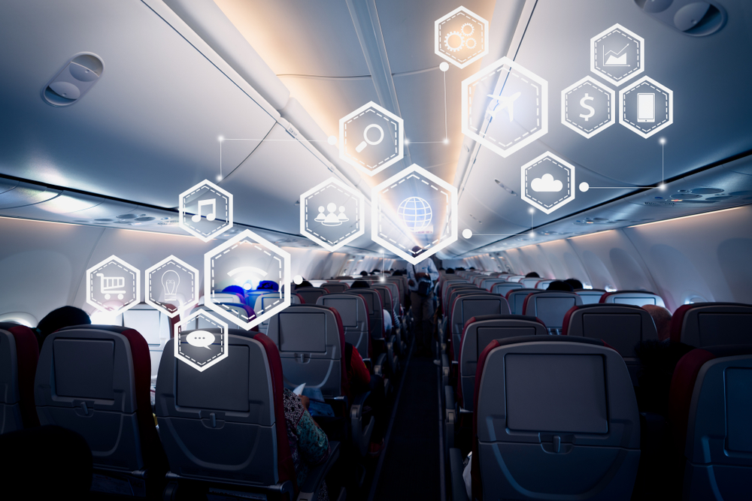
Analysis of Airline Survey Dataset
Sangam Ludhani, Trisha Chakraborty, Aditi Shrivastava, Rahul Rathod, Zhida Liu, NahnsanGuseh

Slide 2
About the Dataset
Number of Columns
28
Customer
satisfaction scale
1-5
Number of records
129889
Number of Airlines
14
Customer Demographics
Age
Gender

Slide 3
Analysis of Airline Survey Dataset
Data Cleaning
Visualization
Linear
Modelling
Correlation
Matrix
Decision
Tree
Association
Rule
Mining
Support
Vector Matrix
Improve customer satisfaction

Slide 4
Business Questions
Which gender either male or female has the higher customer satisfaction rating values ?
Which type of airline status has the highest customer satisfaction rating?
Which travel types have the highest and lowest customer satisfaction rating?
Which age ranges of customers have the highest and lowest customer satisfaction rating?
How does number of flights per annum alter the customer satisfaction rating ?
Why did we choose Only Jet and Going North Airlines as our client?

Slide 5
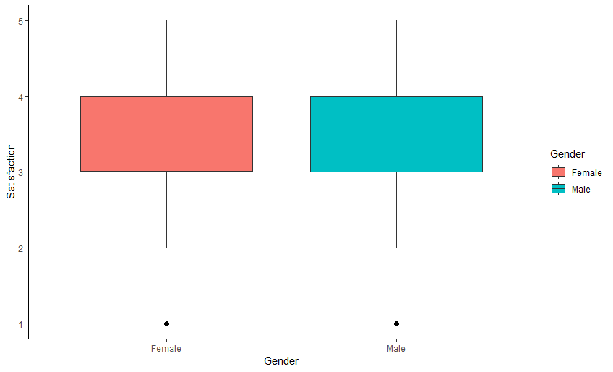
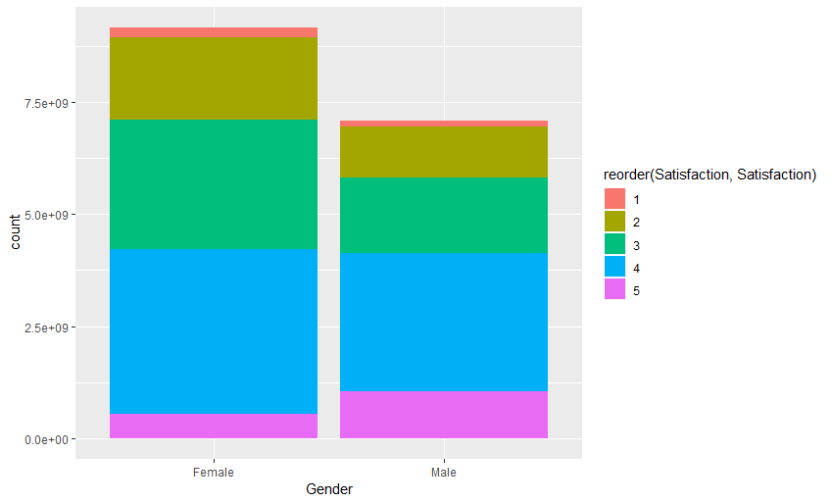
Gender Satisfaction ratings

Slide 6
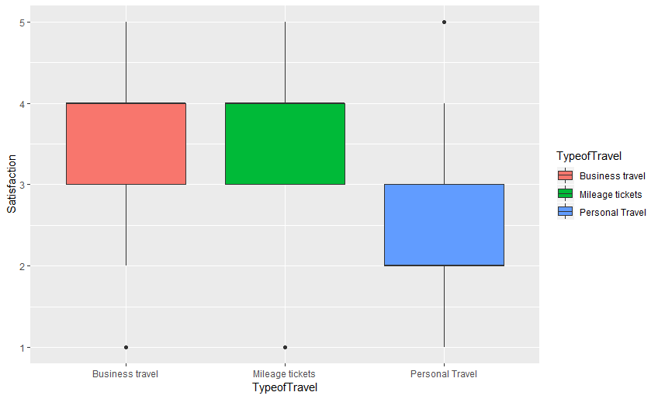
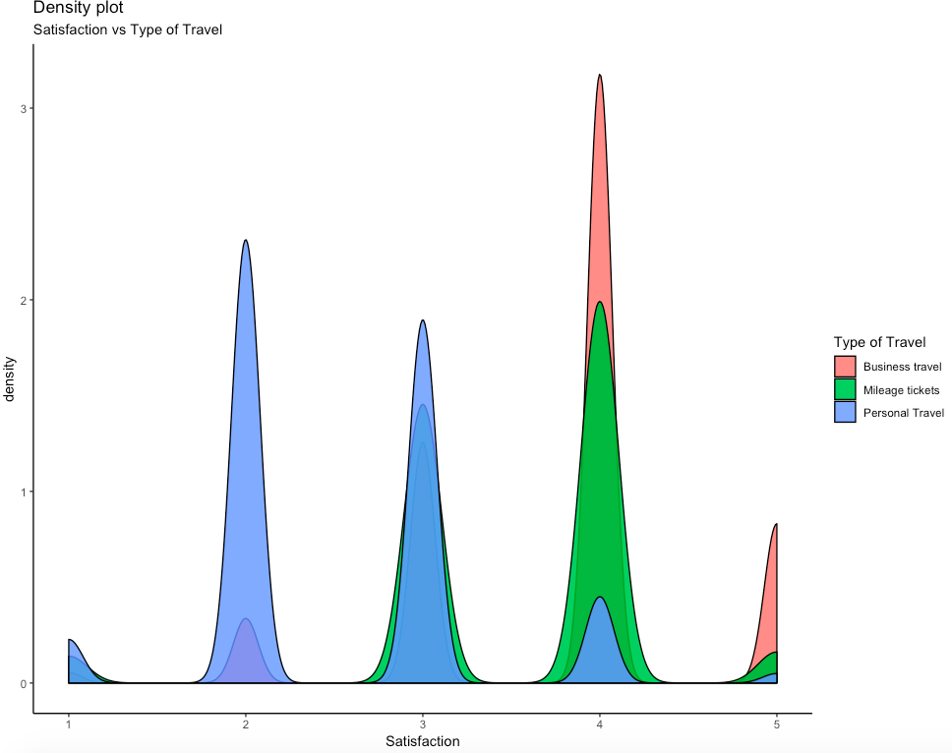
TRAVEL TYPE RATINGS

Slide 7
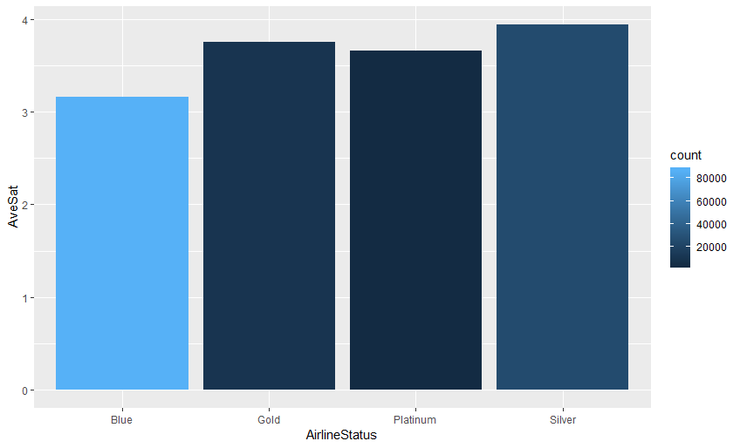
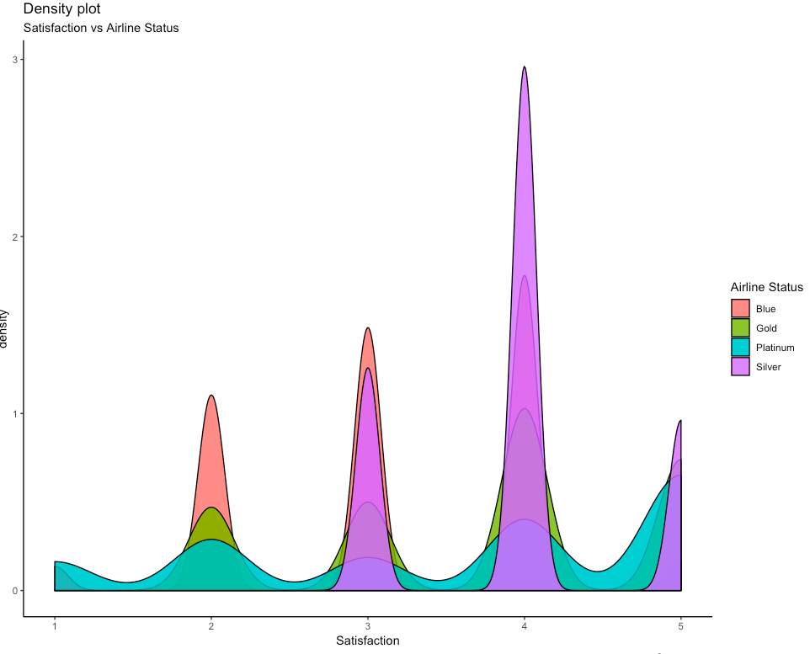
AIRLINE STATUS RATINGS

Slide 8
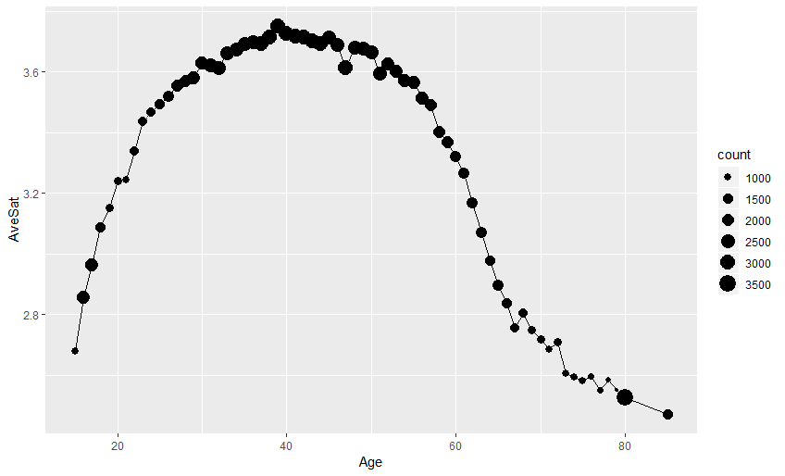
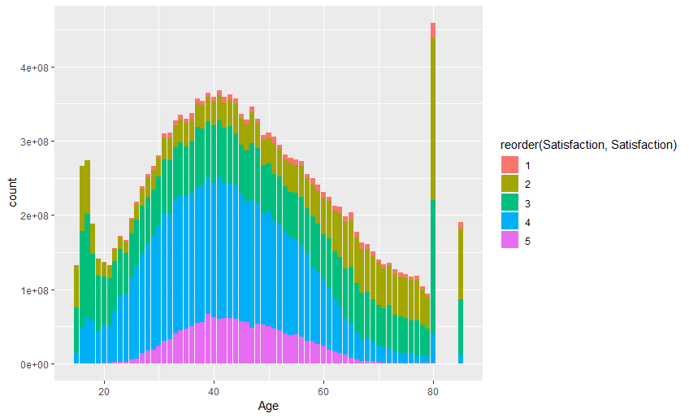
RATING VARIATIONS AS PER AGE RANGE

Slide 9
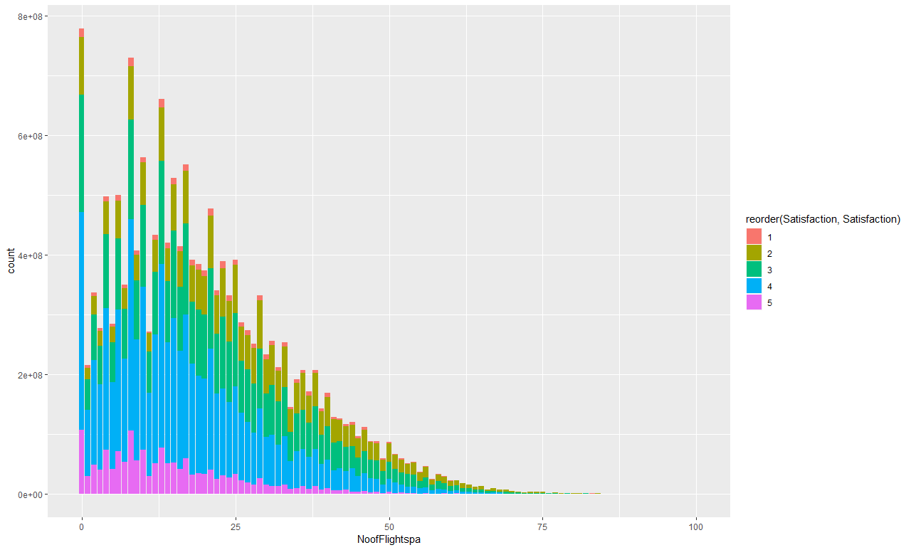
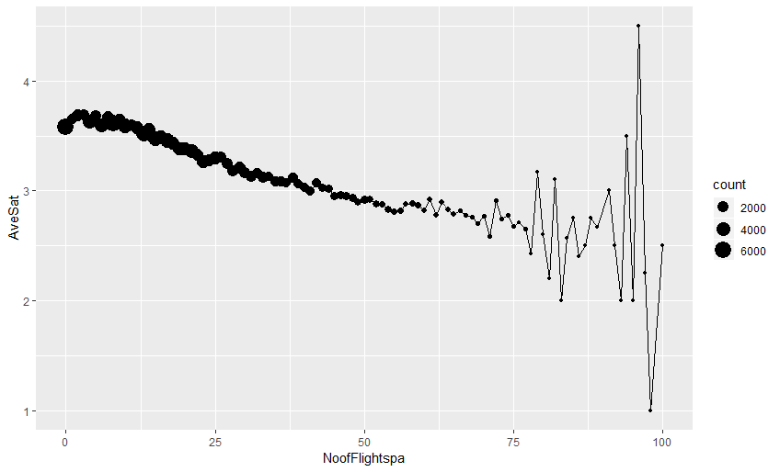
RATING AFFECTED BY FLIGHTS TAKEN

Slide 10
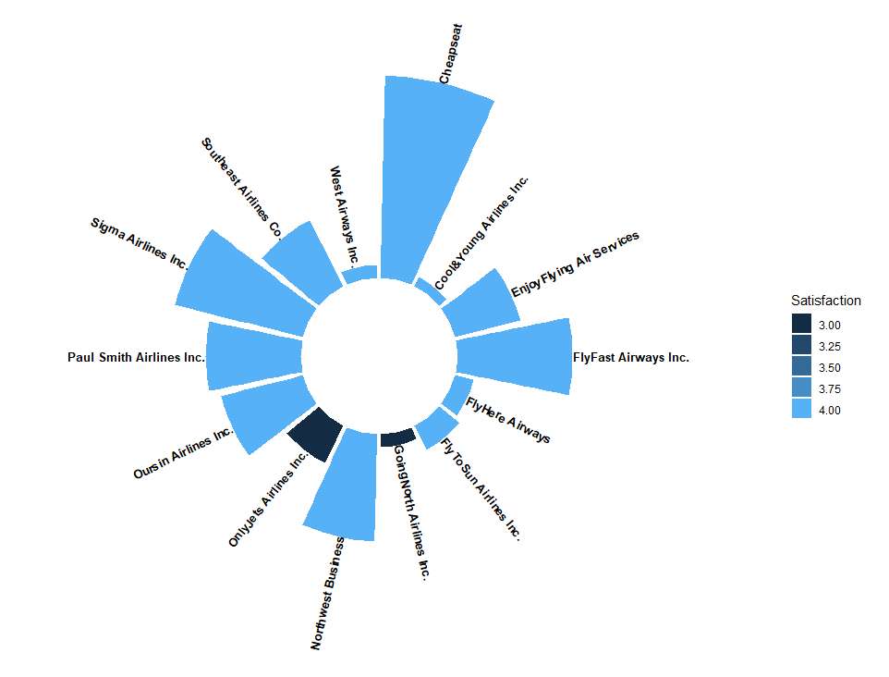
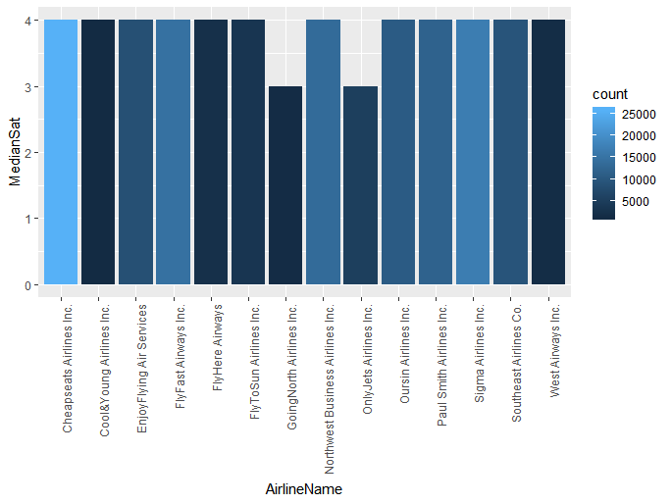
WHY THESE CLIENTS?

Slide 11
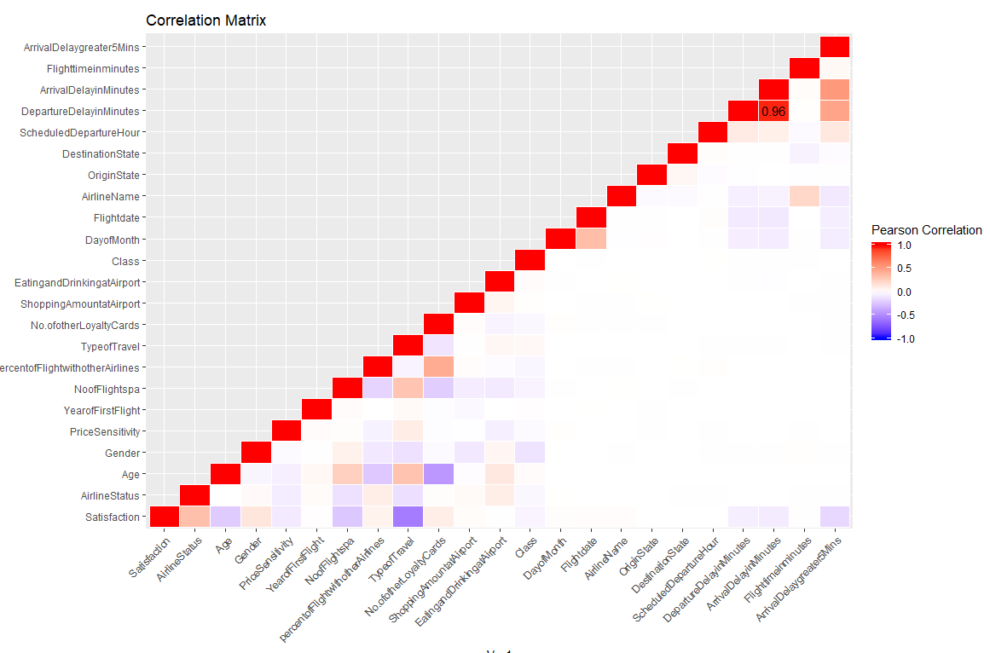
UNDERSTANDING RELATIONSHIP

Slide 12

HOW AIRLINE FACTORS INFLUENCE CUSTOMER SATISFACTION
Through linear modelling, we got 8 significant features out of 28 which are important.
Significant Variables:
Airline Status
Gender
Age
Price sensitivity
Number of flights per annum
Type of travel
Shopping Amount at airport
Arrival delay greater than 5 minutes

Slide 13
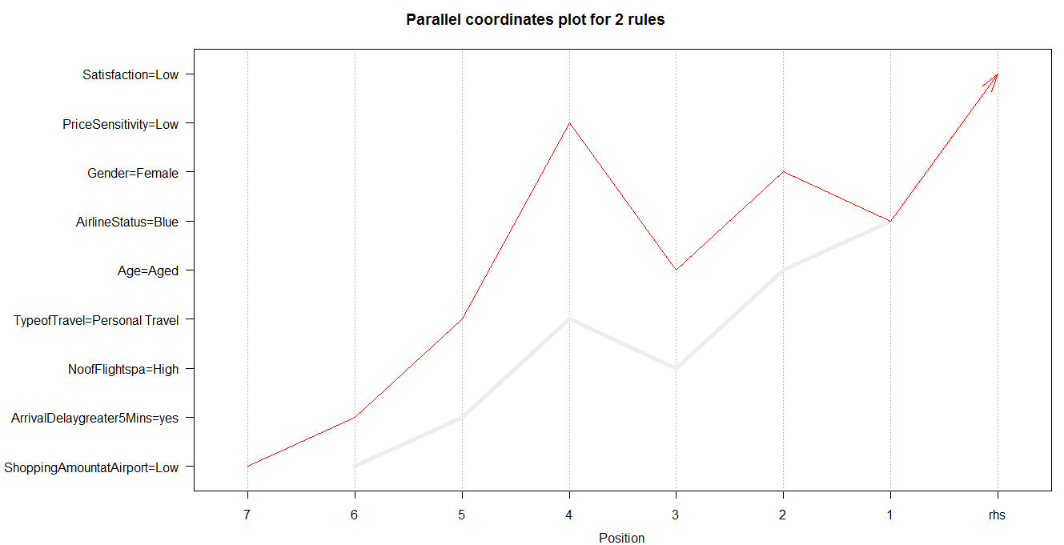
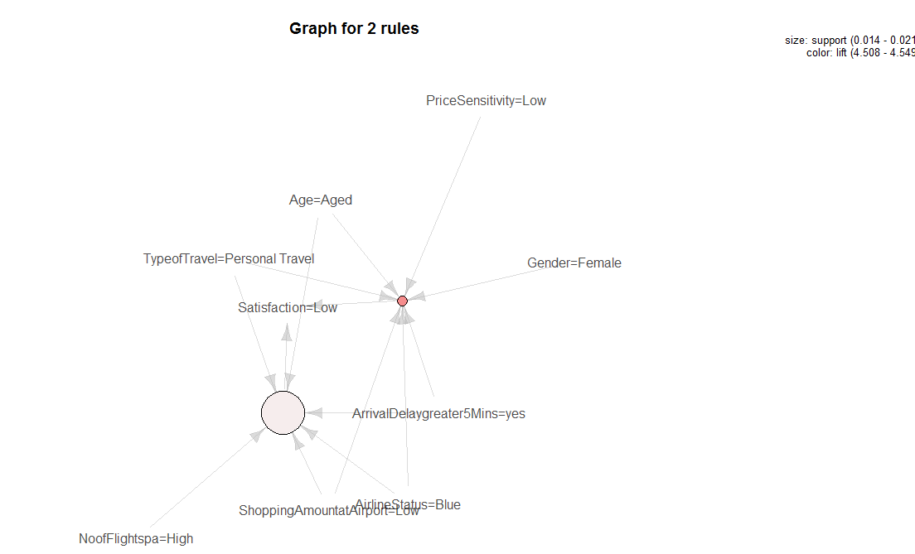
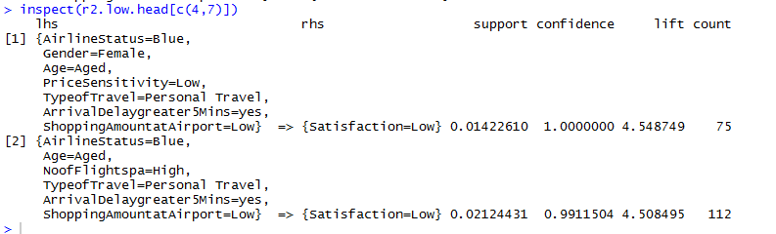
FACTORS COMBINATION AFFECTING RATINGS – ONLY JET

Slide 14
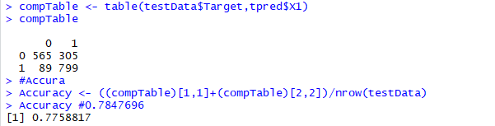
MODELLING TECHNIQUES : SVM & DECISION TREE
Support Vector Machine Results:
Features considered as Input to SVM:
Airline Status
Gender
Age
Price sensitivity
Number of flights per annum
Type of travel
Shopping Amount at airport
Arrival delay greater than 5 minutes
Prediction Efficiency : 80.09%
Decision Tree Results:
Same Features considered as Input to DT:
Prediction Efficiency : 77.58%

Slide 15
RECOMMENDATIONS – ONLY JET
Through Visualisations & modelling these are inferences,
Female customers are giving lower satisfaction ratings and could be offered better deals for improvement
Aged (60-85) customers are using “Personal type of travel” & their average satisfaction is low. Hence, personal travel amenities for senior customers should be increased and they should be well-maintained.
Premium status classes likes Gold, Platinum are having good customer satisfaction whereas Blue has lower ratings. Therefore, extra services should be provided for convenience of customers travelling through Blue status.
Customers taking more flights per year are giving low satisfaction ratings. Thus, loyal customers should be provided with discounts and points which might satisfy them in long run .

Slide 16
Thank You….

